Slide 1


Slide 2
Books
C# 4.0 The Complete Reference; Herbert Schildt; McGraw-Hill Osborne Media; 2010
Head First C# by Andrew Stellman
Fundamentals of Computer Programming with CSharp – Nakov v2013

Slide 3
Course Title: OOP 2 Course Code: CSC 2210
Dept. of Computer Science
Faculty of Science and Technology
Topics: Class & Object, Encapsulation
Lecturer No: | 04 | Week No: | 04 | Semester: | Fall 2022-23
Lecturer: | Nyme Ahmed (nyme.ahmed@aiub.edu)

Slide 4
Class & Object
In Visual C#, you can define your own custom types by creating classes. As a programming construct, the class is central to object-oriented programming in Visual C#. It enables you to encapsulate the behaviors and characteristics of any logical entity in a reusable and extensible way.
The class defines the behaviors and characteristics, or class members, which are shared by all instances of the class. You represent these behaviors and characteristics by defining methods, fields, properties, and events within your class.
Class is a blueprint of an object. A class can be thought as a “type”, where the objects being a “variable” of that type.

Slide 5
Class & Object
Classes are reference type. There are two fundamental types of classes.
Concrete: You can create instances of them
Abstract: You can’t create instances of them
You use the ‘class’ keyword to declare a class, as shown in the following example:
//declaring a class
public class DrinkMachine
{
//methods, fields, properties, events
}
Here, the class keyword is preceded by an access modifier, such as public.

Slide 6
Class & Object
Classes can have the following members.
Constructor/Destructor
Fields
Methods
Indexers
Properties
Delegates and Events
Other types (e.g. structs, enums, interfaces, classes…)
Classes can implement interfaces and inherit from other classes.

Slide 7
Encapsulation
Encapsulation often considered the first pillar of object oriented programming.
Encapsulation can be used to describe the accessibility of the members belonging to a class or struct.
C# provides access modifiers and properties to help implement encapsulation in your classes.
Access modifiers control the “visibility” of a type or member to the types and members.
There are 5 types of access modifier.

Slide 10
Constructor
A special method of the class that will be automatically invoked when an instance of the class is created is called a constructor.
When you have not created a constructor in the class, the compiler will automatically create a default constructor in the class.
A constructor doesn’t have any return type, not even void.
A class have any number of constructors.
As any other method, constructor can be overloaded.

Slide 11
Constructor
There are 4 types of constructor in C#.
Default or Parameter less Constructor
Parameterized Constructor
Copy Constructor
Static Constructor
Default Constructor: It initializers-
All numeric fields in the class to zero.
All string and object fields to null.
This is the drawback of default constructor!!
(every instance of the class will be initialized to the same values)

Slide 12
Constructor
Parameterized Constructor:
A constructor with at least one parameter is called parameterized constructor.
The advantage of parameterized constructor is that you can initialize each instance of the class to different values.
Copy Constructor:
The constructor which creates an object by copying variables from another object is called a copy constructor.
The purpose of copy constructor is to initialize a new instance to the values of an existing instance.

Slide 13
Constructor
Static Constructor:
A static constructor does not take access modifiers or have any parameters.
A static constructor cannot be called directly. It called automatically to initialize the class before the first instance is created or any static members are referenced.
When a constructor is created as static, it will be invoked only once for all of instances of the class.
Within a class you can create only one static constructor.
The user has no control on when the static constructor is executed in the program.

Slide 14
Destructor
Destructor are the methods called by the Garbage Collector thread when the object is to be “finalized” (removing objects from memory).
C# destructors are “non-deterministic” i.e. finalization cannot be determined when that will happen.
In C#, most of the time you do not need to code destructor (or finalize) because you can trust Garbage Collector for that.

Slide 15
Fields
Called the state of objects. Variables declared outside any method /constructor but inside the class block, is a field (or field variable).
Variables that are declared within a method or a specific block of statements are local variables.
Local variables are kept alive as long as the execution is within the block they’re defined in. Once the block is exited, the local variables can no more be used. | Field variables have longer life than local variables in that they can live as long as the instance they belong to is active.
Local variable access is restricted to method only. | Field variable is the one which can have different access level.
Local variable is a member of a method. | Field variable is a member of a class.

Slide 16
Fields: Readonly
The keyword “readonly” will prevent field variable from being reassigned (from outside the class). The readonly keyword cannot be applied to local variables but to fields only.
The readonly keyword is different from the const keyword.
A const field can only be initialized at the declaration of the field whereas a readonly field can be initialized either at the declaration or in a constructor.
While a const field is a compile-time constant, the readonly field can be used for runtime constants.

Slide 17
Properties
A property is a programming construct that enables client code to get or set the value of private fields within a struct or a class. The property behaves like a public field.
The property is implemented by using accessors, which are a special type of method. A property can include one or both of the following:
A get accessor to provide read access to a field.
A set accessor to provide write access to a field.
Within the property, the get and set accessors use the following syntax:
The get accessor uses the return keyword to return the value of the private field to the caller.
The set accessor uses a special local variable named “value” to set the value of the private field. The value variable contains the value provided by the client code when it accessed the property.

Slide 18
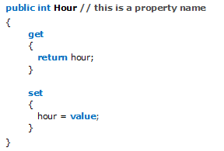
Properties
Example:
A property that includes only a get accessor is read-only, while a property that includes only a set accessor is write-only.

Slide 19
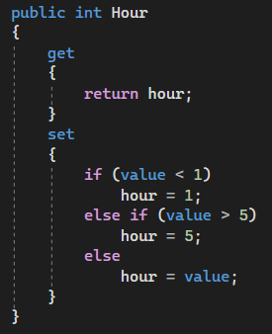
Properties
You can change the implementation of properties without affecting client code.
For example, you can add validation logic, or call a method instead of reading a field value.

Slide 20
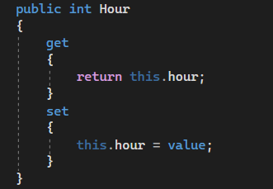
Indexers
An indexer is similar to a property, in that it uses get and set accessors to control access to a field.
To declare an indexer, you use the “this” keyword.

